Slide 1
VTT – your research, development and innovation partner
Notes:
VTT is a visionary research, development and innovation partner for companies and the society, and one of the leading technical research organisations in Europe.

Slide 2
Search-augmented genertation
We help our customers and partners to build new business and find sustainable solutions to global challenges through science and technology. Our role is to promote the utilisation and commercialisation of research and technology in business and society.
Notes:
We turn science into practical innovations
Research, development and innovation (“RDI”) within VTT is divided into three Business Areas: Carbon neutral solutions; Digital technologies; and Sustainable products and materials.
We explore tomorrow’s technologies and innovate cutting-edge solutions to build the carbon neutral societies of the future, be smarter about how we use limited natural resources like metals, develop lean and cost-effective energy for everyone, and put quantum computers to work. Our main task is to help businesses to utilize the advancements of science and technology in their work – through our customers, these innovations can become a part of people’s everyday lives.
We need thinking that is beyond the obvious. To make sure we focus on the right things, VTT has chosen areas of major challenges and growth opportunities: specialized areas of cutting-edge research, solutions and possibilities for collaboration.

Slide 3
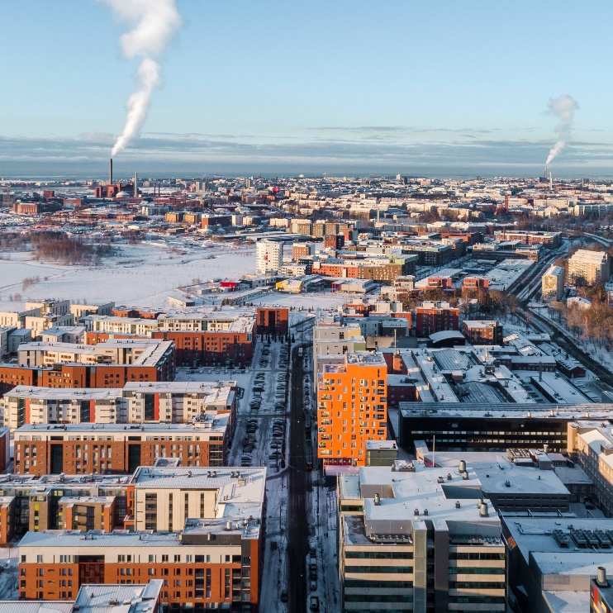
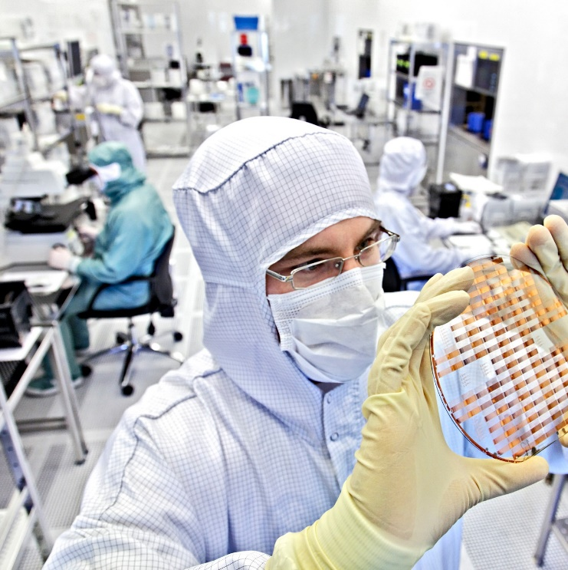
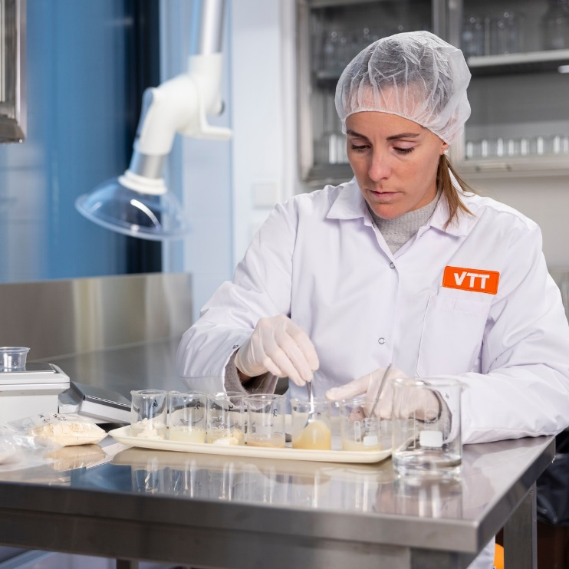
We create solutions in three business areas
We help our customers and partners to build new business and find sustainable solutions to global challenges through science and technology. Our role is to promote the utilisation and commercialisation of research and technology in business and society.
Carbon neutral solutions
Digital technologies
Sustainable products and materials
Notes:
We turn science into practical innovations
Research, development and innovation (“RDI”) within VTT is divided into three Business Areas: Carbon neutral solutions; Digital technologies; and Sustainable products and materials.
We explore tomorrow’s technologies and innovate cutting-edge solutions to build the carbon neutral societies of the future, be smarter about how we use limited natural resources like metals, develop lean and cost-effective energy for everyone, and put quantum computers to work. Our main task is to help businesses to utilize the advancements of science and technology in their work – through our customers, these innovations can become a part of people’s everyday lives.
We need thinking that is beyond the obvious. To make sure we focus on the right things, VTT has chosen areas of major challenges and growth opportunities: specialized areas of cutting-edge research, solutions and possibilities for collaboration.

Slide 4
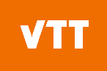
We help our customers turn science into practical innovations
Private sector
Valley of death
Governments and universities
Public / Private collaboration
Investment
Basic research
Applied research
Technology development
Prototype and system development
Technology Readiness Level (TRL)
1
Basic principles
2
Technology concept
3
Proof of concept
4
Tech validated in lab
5
Tech validated in relevant environment
6
Tech demonstrated
7
System prototype
8
System complete and qualified
9
System deployed
Notes:
Innovations emerge when applied research works with industry to translate the new knowledge and understanding produced by basic research into practice. Applied research organisations such as VTT are vital, because they are able to engage in long-term research and development that would be a risky investment for businesses, and on the other hand they are able to help industries commercialise new scientific breakthroughs.
Validating the technology is crucial before entering the market. At VTT, we help our customers to assess the viability and scalability of their technological solution, and to scale up ideas to industrial use. We have invested in science-based expertise and piloting infrastructure for decades so our customers can take the fast lane to breakthroughs.

Slide 5




















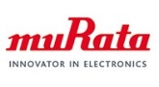



























Cooperation with us promotes sustainable renewal of trade and industry
Notes:
Here are some examples of our major customers.

Slide 6



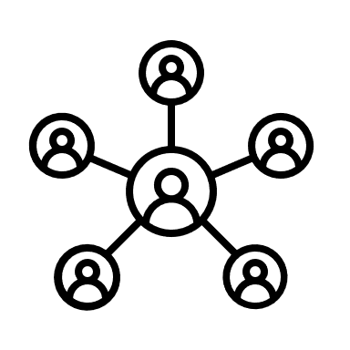

VTT’s Role in Innovation Collaboration
Context: We are interested in VTT’s involvement in collaborations related to
innovation publicly disclosed on the websites of past collaboration partners.
1
2
3
4
5
Past VTT’s
Collaboration
Partners
Disclosure of
VTTs on Partner
Website
Scraping:
Page Content
+ Metadata
LLM-based
Relationship
Extraction
Challenge:
Innovation
Resolution
Notes:
”
Organizational websites offer some of the richest and most dynamic traces of what millions of companies and institutions are doing. Strategy, products, partnerships, technologies, sustainability efforts. It’s all there, right in the open. Used well, this data allows us to track innovation and economic development as it unfolds across sectors, regions, and networks. But… tread carefully. Because the data is a little wild. It’s large, noisy, and biased. Trying to extract real insight with keyword searches alone is like trying to understand a symphony by picking out a few notes. If we keep using old-school tools, we’ll be mistaking noise for signal and PR for practice.
”

Slide 7

The Problem: Innovation Duplication
Challenge Step 1:
Innovative Resolution
When are different sources discussing the same innovation?
→ Use the associated organisations, provided description or source text to identify duplicates.
Challenge 2:
Innovation Relationship
How are the different disclosures related?
→ Find a representation that aggregates the information describing one innovation, without losing source information.

Slide 8

To find a Winner, we evaluate...
way towards solution:
outcome:
... deployed METHOD.
+
... chosen EVALUATION.
... absolute DEDUPLICATION. +
... (concept of) data AGGREGATION.

